Slide 1

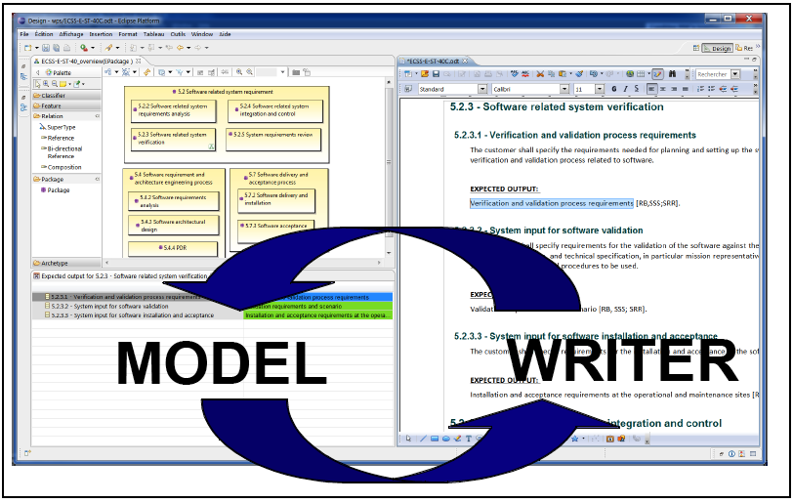
ModelWriter Text & Model-Synchronized Document Engineering Platform
Project Leader: Ferhat Erata (ferhat@computer.org)
Project Email: project@modelwriter.eu
Notes:
I’d like to begin by thanking you all for coming today.
My name is [Ferhat Erata] from [UNIT Information Technologies Research & Development].
I am the project leader of ModelWriter project.
Before starting the presentations, I would like to invite review chairman to make the introductory speech for today’s review.
1

Slide 2
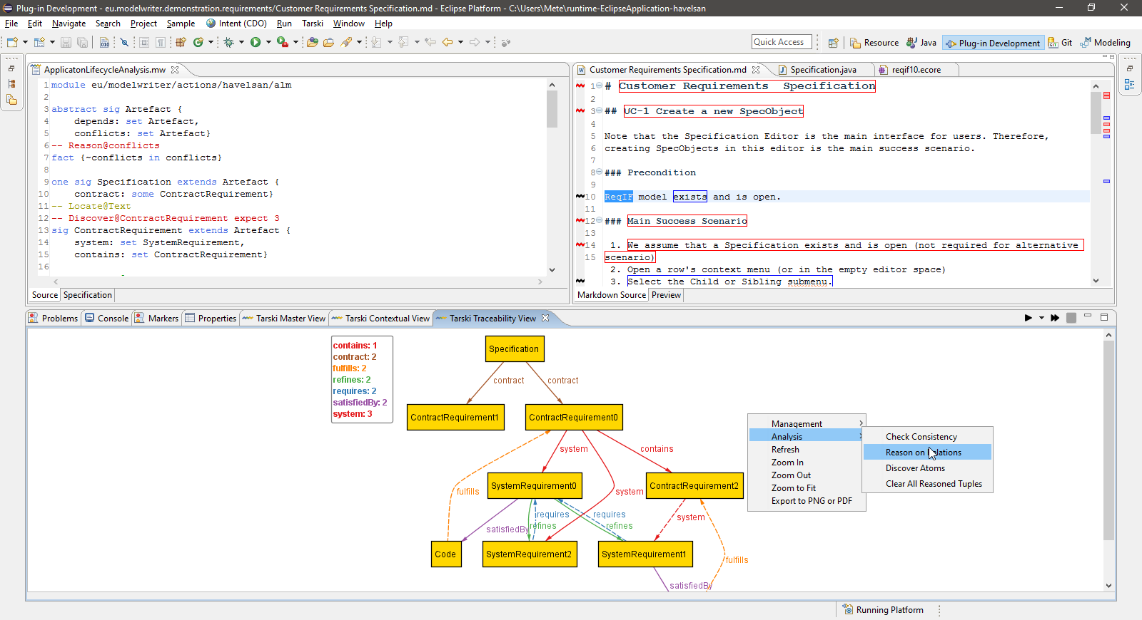
ModelWriter Text & Model-Synchronized Document Engineering Platform
Project Leader: Ferhat Erata (ferhat@computer.org)
Project Email: project@modelwriter.eu
Notes:
The graphics on the former slide was a mock-up that shows what was envisioned before starting off the project. The latter one, this one, clearly shows that we achieved the goal of having a working User Interfaces on Eclipse platform. That was what we as we anticipated.
2

Slide 3
1 Introduction
Ferhat Erata
UNIT, ModelWriter Project Leader
Notes:
Let me introduce the partners attends today’s meeting. I have already introduced myself.
Let’s begin with CNRS/LORIA, Prof. Claire, could you introduce yourself and your research organization…
3

Slide 4








Participants ModelWriter #1 Review
Ferhat Erata
Dr. Moharram Challenger
Hasan Emre Kirmizi
Yvan Lussaud
Etienne Juliot
Dr. Eray Tuzun
Yagup Macit
Tuğçe Yiğiter
Alan Endersoy
Dr. Emrah Kinav
Dr. Guven Köse
Omurhan Soysal
Aydin Can Polatkan
Dr. Claire Gardent
Dr. Samuel Cruz-Lara
Bikash Gyawali
Anastasia Shimorina
Dr. Geylani Kardas
Mehmet Onat
Hale Gezgen
Ersan Gürdoğan
Taskin Kızıl
Oguz Yavuz
Dr. Anne Monceaux
Notes:
Let me introduce the partners attends today’s meeting. I have already introduced myself.
Let’s begin with CNRS/LORIA, Prof. Claire, could you introduce yourself and your research organization…
I would like to specially thank Claire for hosting the meeting, to Vincent for his mentorship.
4

Slide 5
Agenda [13:00 - 17:00]
Introduction (5 mins) [13:00 - 13:05]
Overview of the project (WP5) (15 min) [13:05 - 13:20]
Industrial Use Cases (WP1) (20 min) [13:20 - 13:40]
Technical Presentations (WP2, 3 & 4) (45 mins) [13:40 - 14:25]
User Interfaces & Integration (WP6) (10 mins) [14:25 - 14:35]
Break (15 mins) [14:35 - 14:50]
Exploitation Related Activities (WP7) (10 mins) [14:50 - 15:00]
Demonstrations (60 mins) [15:00 - 16:00]
Conclusions (10 mins) [16:00 - 16:10]
Reviewers’ Private Section (30 min) [16:10 - 16:40]
Feedback Session (15min) [16:40 - 16:55]
Final Words (5 min) [16:55 - 17:00]

